Slide 1

The Snake Game.
The Snake Game AI.
A Presentation by:
Kenneth Xavier D’silva (ID: 10600644)
And Sunil Gauda (ID:

Slide 2
Content:
1.Basic Model: Explanation of the State, Action and Rewards Parameters.
2.Basic Model: Parameter Explanation and exploration vs exploitation factors.
3. Basic model: training
4. Mathematical model : Hamiltonian cycle.
5. Advanced model: a* Rl technique with Hamiltonian cycle.

Slide 3
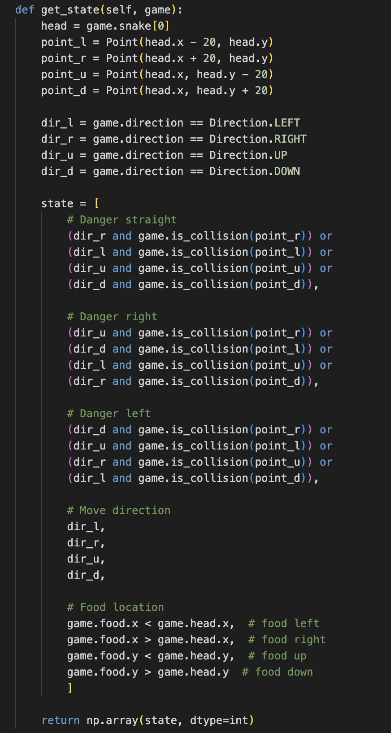
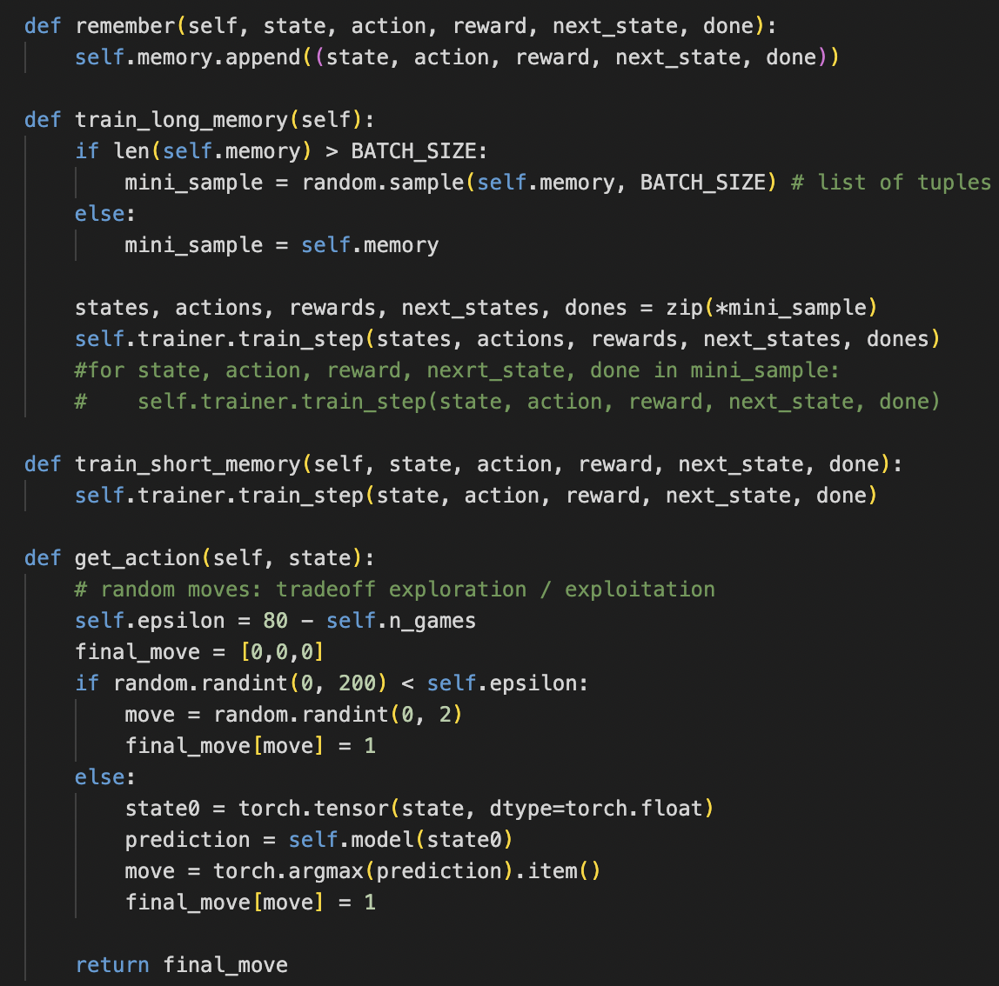
The Base Model.
This model is the baseline model on which the improvements are made on. Here we introduce three sections:
Agent: This python code gets the state of the snake, creates “next move danger” parameters, and gets the location of the food.

Slide 4
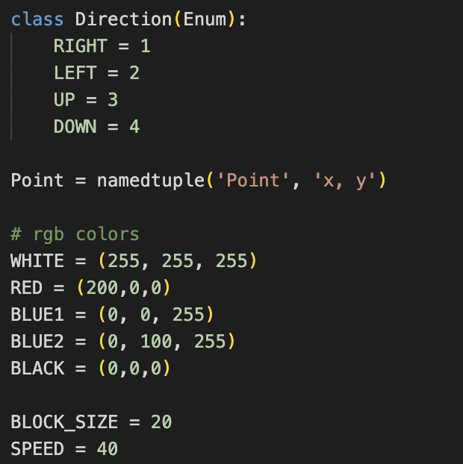
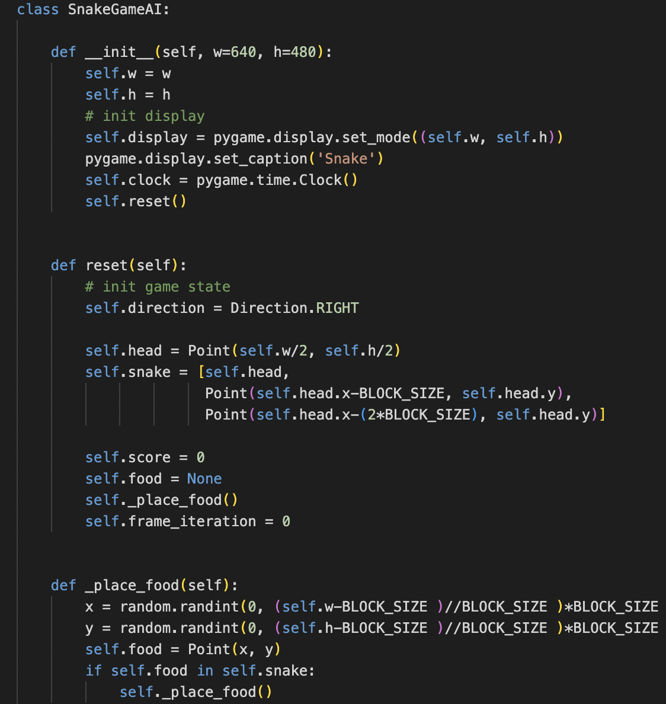
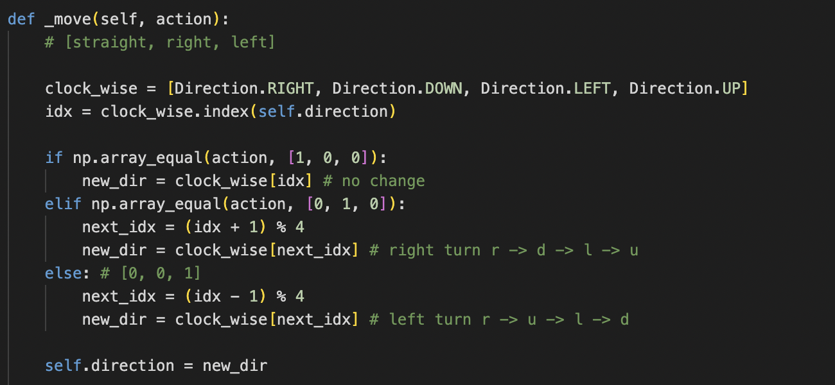
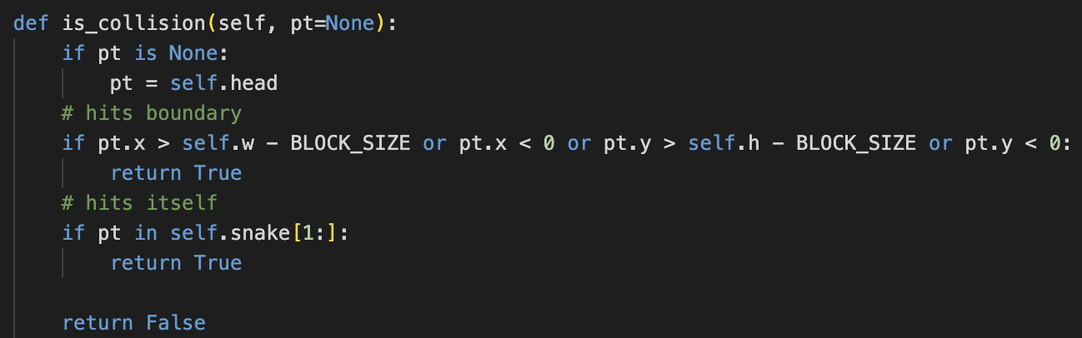
2. Game: This is the building block of the Game UI. It creates the Game Space and Color Schemes but is also the entry point of the game. It consists of functions that allow the food to be placed at random datapoints, Update the head with the new step, tracks the Reward function, checks for collision of the head with the boundary or body and tracks the points and deaths along with win per game average.

Slide 5
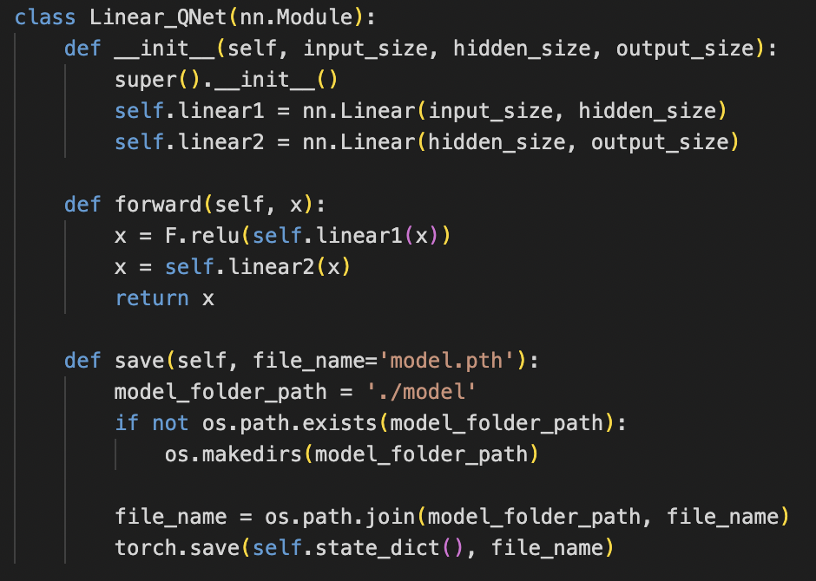
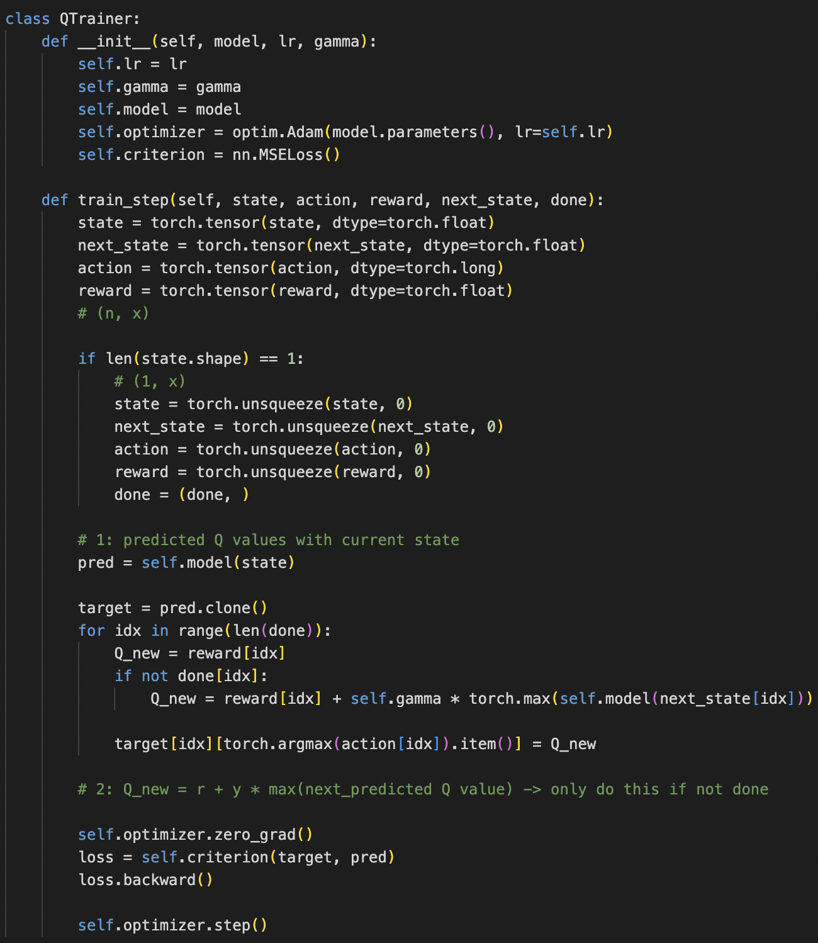
3. Model: This introduces the Q-Net model and is mainly programmed to take actions of the next state, and what the reward will be and also to predict the Q-Value of the current state.
This is where the Neural Network with the Adam Optimizer is created and implemented.

Slide 6
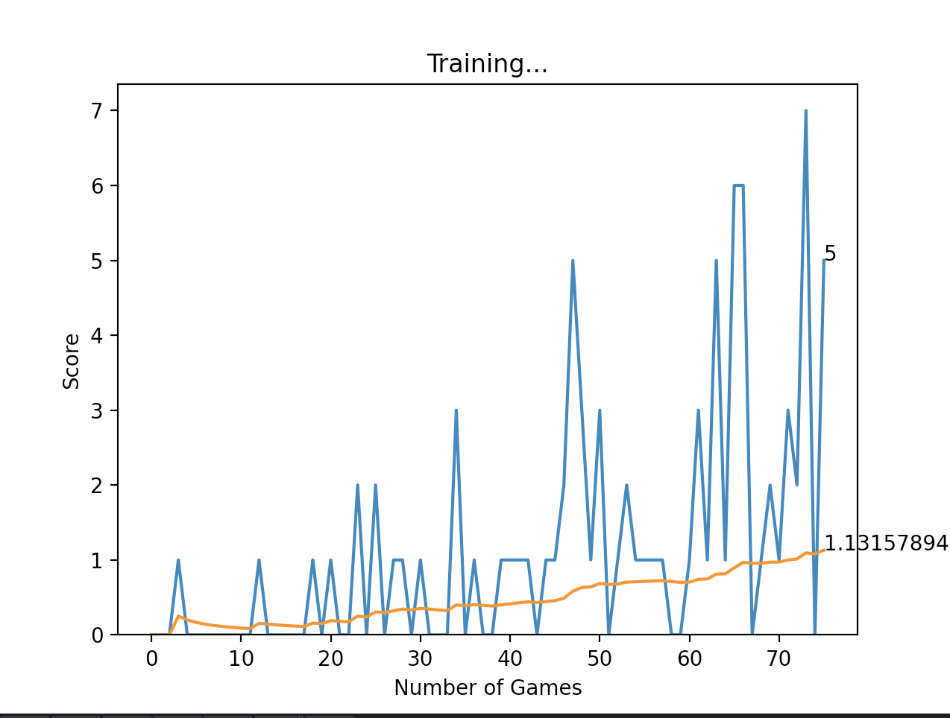
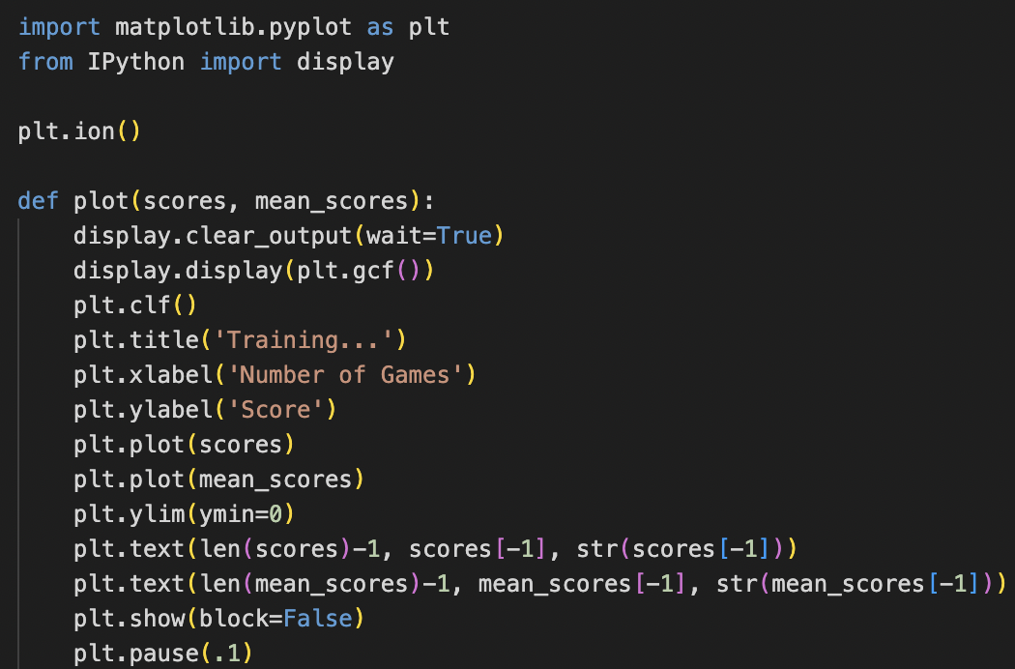
Helper: The Helper creates a UI using matplot library. It creates a plot graphing out the number of games with the number of wins in that specific game. Towards the end it also calculates the average of games played with respect to the points won by successfully eating the food per game.

Slide 7
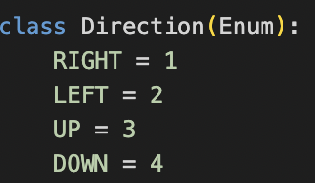
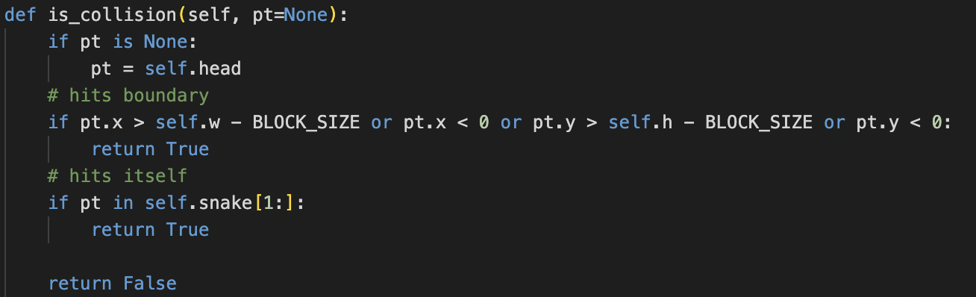
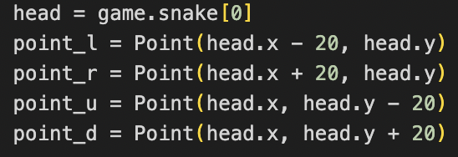
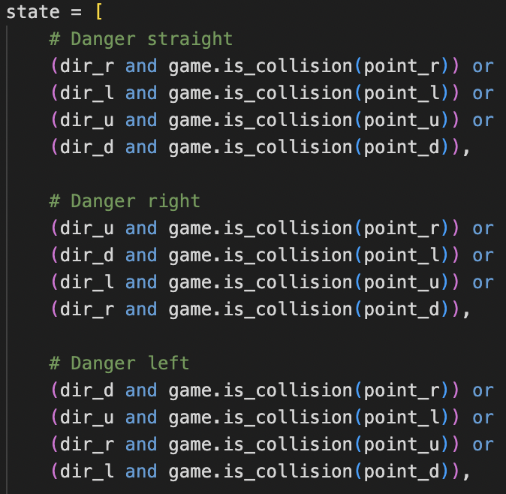
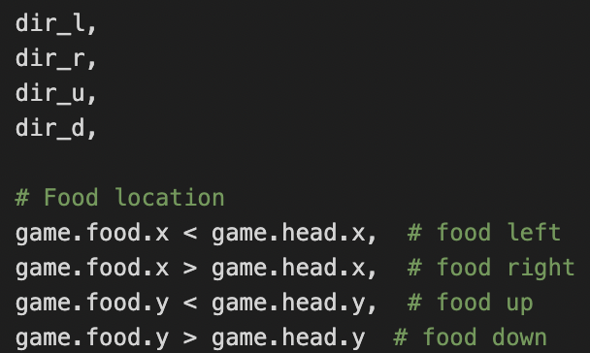
Parameters and Exploration vs Exploitation.
Parameter Explanation: The Direction Class creates the movement paramerters where the snake chooses the next state.
The is_collision definition checks if the snake collides with itself or the boundary.
The get_state function returns an array of the head direction, the state to detect where the danger is, the allowable movement directions available and food location.

Slide 8
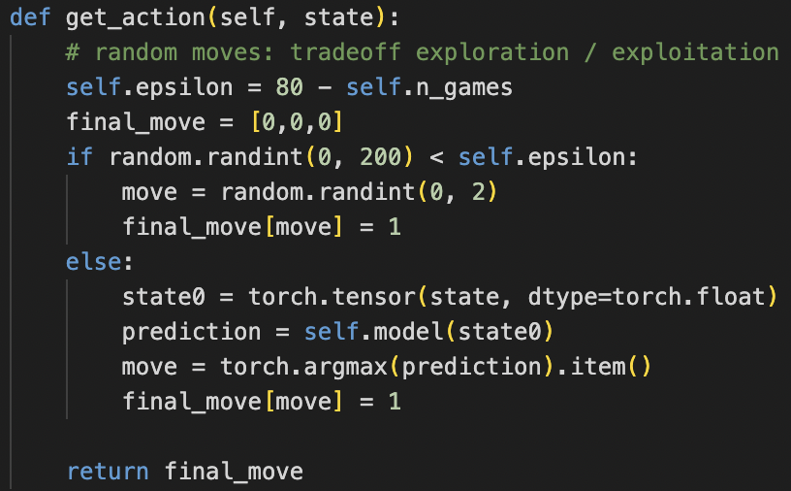
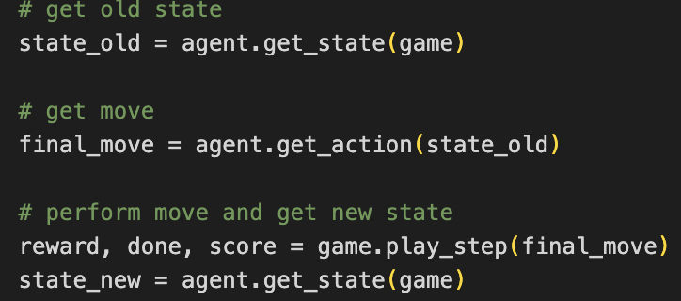
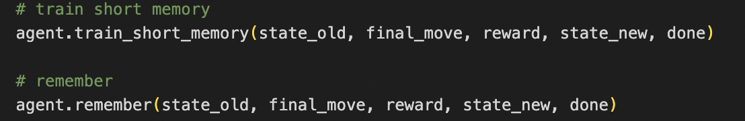
The exploration and exploitation is controlled by the epsilon parameter. Here, 80% of the Q-learning is set up at exploitation and 20 for exploration. This allows the snake to use the learned safe moves 80% of the time and exploit new movements 20% of the times. Hence, using the safe moves yet exploiting new ways in the process.
The train definition helps get the old state, old move, the old reward and provide it to the Q-learning model to predict the future state and to get to the next state with the move to get to it.
Finally, the state-action and rewards need to be stored, hence a short term and long term memory is trained where the past state-action rewards are stored. The short term memory is used for decision making during the games and the long term memory is used during epocs.

Slide 9
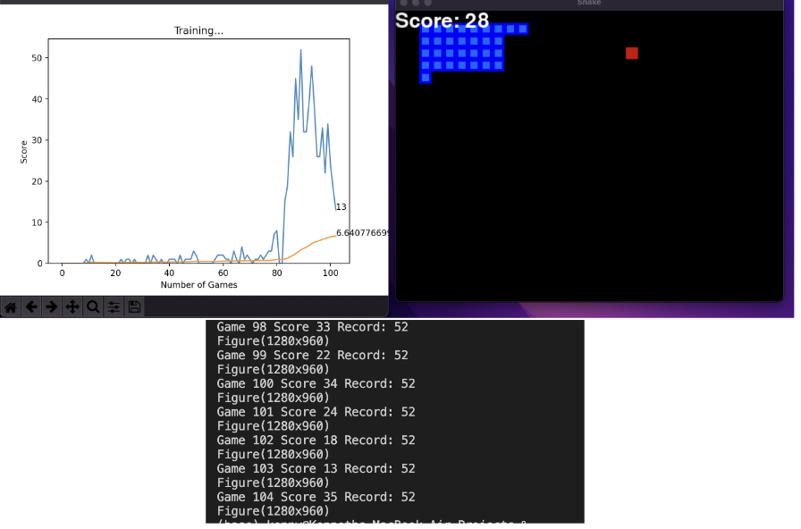
Base Model: Training.
The training of the Snake takes around 60 minute to perform average, the increase in learning rate allows it to speed up the learning yet it dies of causing self consumption or infinite loop problems. Hence, we include a mathematical Hamiltonian model with some Advanced algorithm as the A* search algorithm.

Slide 10
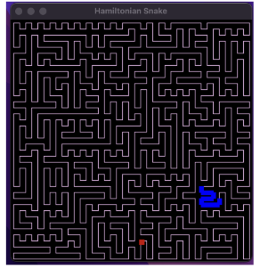
Mathematical Model: Hamiltonian Cycle
The Hamiltonian Cycle or the Hamiltonian path is an algorithm used to solve Maze Games and create a predetermined path in a localized area or set of points. The Hamiltonian Path in this use case is a directed graph that visits a vertice just once but never more than once.
Here, the snake follows the same path until the very end of the game, however the time taken to complete the game is extremely high as this method is useful towards the later part of the game but completely time wasteful in the initial part of the game.

Slide 11
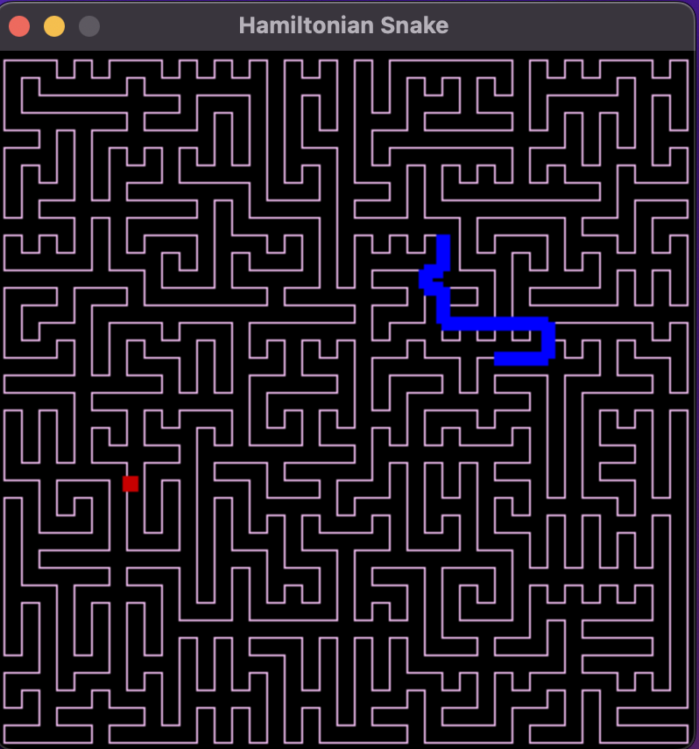
Advanced Model
This model is derived from the Base model and the Mathematical Hamiltonian Cycle
Here the snake makes decisive decisions and using the A* Algorithm finds the shortest path to the food. Moving is now more diagonal than path following. Hence, the fetching of food is faster in the initial phase.
When the snake grows larger it begins following the Hamiltonian Cycle to continue.

Slide 12
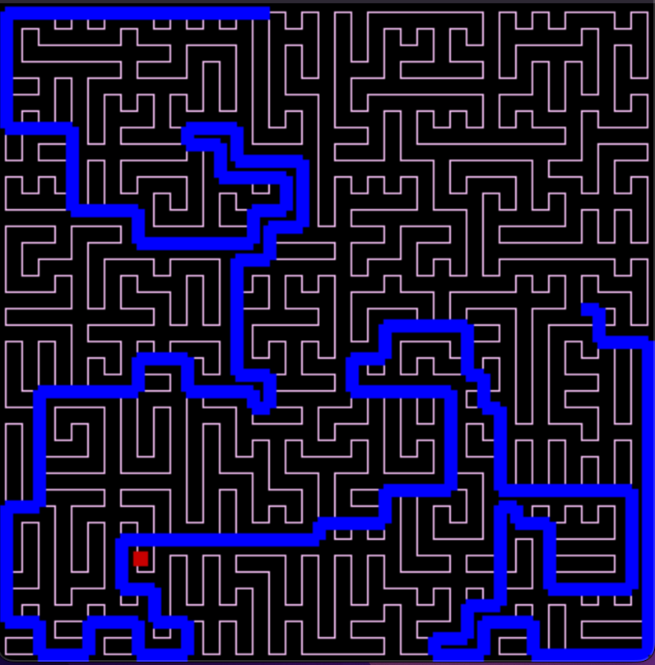
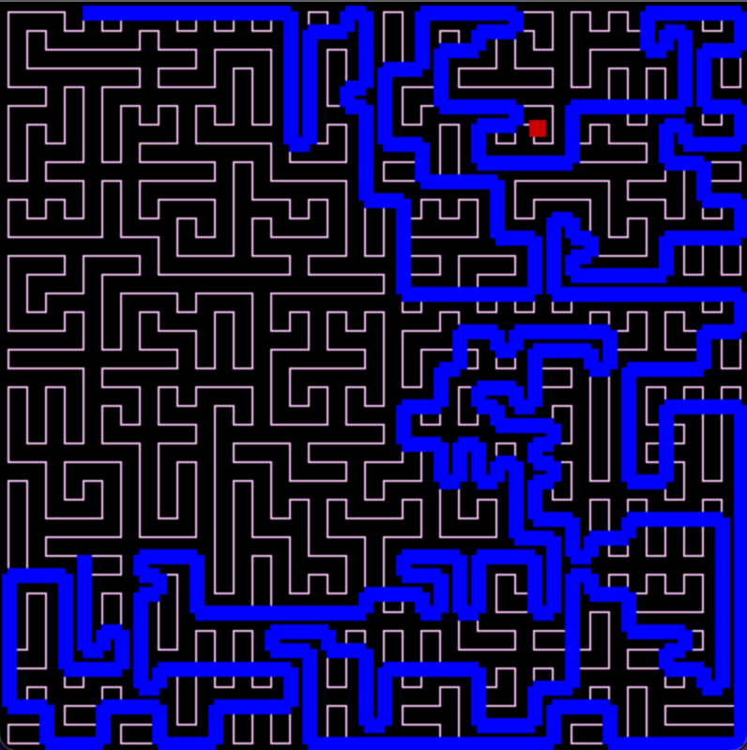
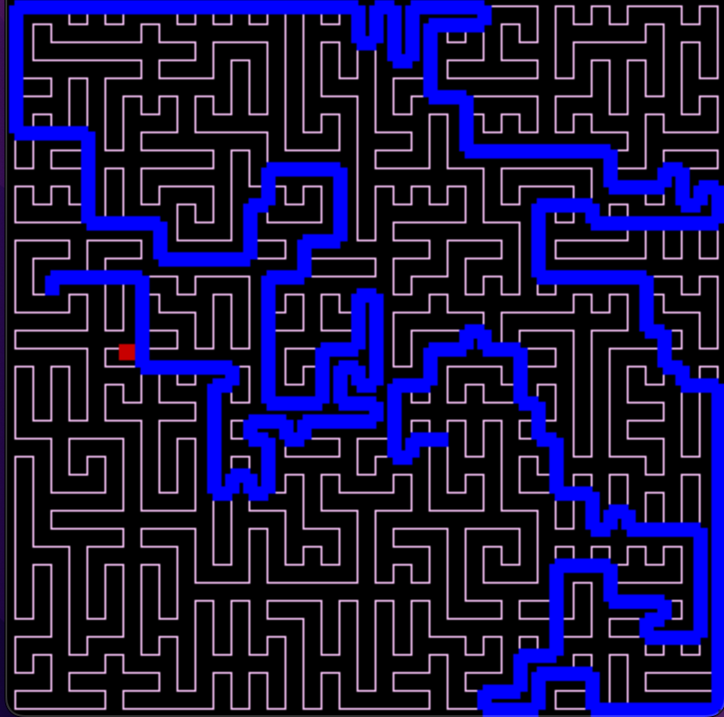
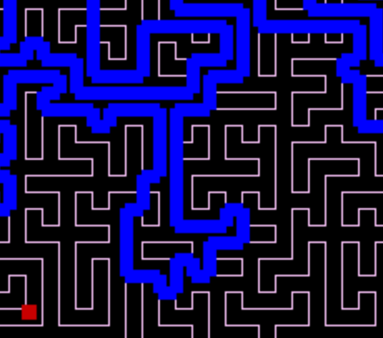
Conclusion
Towards the end of our journey, we created one perfect snake using the A* algorithm and the Hamiltonian cycle mathematical model.
With the inclusion of reinforcement learning A* algorithm to take shortcuts and the mathematical model of maze finding we have created safe shortcuts declared that can help the snake take decisions in the initial period and follow the Hamiltonian cycle in the advanced stage to complete the game in a short time possible.

